Slide 1





Odoo ERP Project “ ATA Pharmacy Data Analysis and Business Intelligence Dashboard”

Slide 2

Project Team
Asmaa Hussein Zayed
Dalia Ashraf Nour
Hager Saleh Ahmed
Mahmoud Ashraf Mohamed
Omar Abd El-Moneam Marouf
Sarah Ahmed Mohamed
Group Code:
ONL2_DAT1_G8
Technical Instructor:
Jakie Abu Aleam

Slide 3

Agenda: Project Overview Problem Statement Objectives Data Exploration Data Analysis and Dashboards Key Insights

Slide 4
Goal: Pharmacy Data Analysis and Interactive Dashboard. Tools used: Odoo: Data Source. Python: ETL (Extract, Transform, Load) Data SQL: Storing and processing Data Power BI: Building an interactive dashboard. Benefits: The primary objective is to leverage data-driven insights to enhance decision-making, drive sales growth, improve operational efficiency.
Project Overview

Slide 5
Problem Statement: Pharmacies generate large volumes of sales and inventory data, but without proper analysis, valuable insights remain untapped. Manual reporting methods are time-consuming, error-prone, and lack real-time visibility into trends and inventory. Consequences: - Leads to stock shortages or overstocking - Missed sales opportunities - Difficulty in making strategic decisions - Absence of a centralized business intelligence system makes it hard to track performance and optimize operations. Solution: This project addresses these challenges by leveraging Odoo, SQL, Python, and Power BI to create an interactive dashboard that delivers real-time insights and supports data-driven decision-making.

Slide 6
* Extract and structure data from Odoo ERP. * Automate ETL processes with Python * validate data * Develop interactive Power BI dashboard * Deliver insights on sales, inventory, and customer behavior
Goals & Objectives:

Slide 7
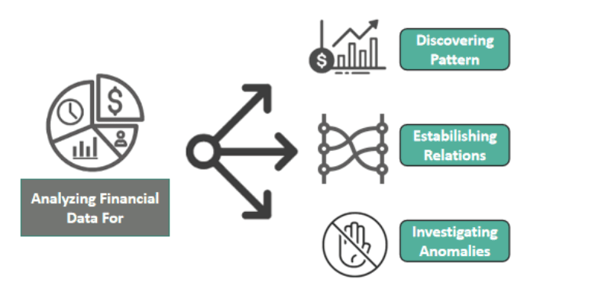
Data Exploration

Slide 8
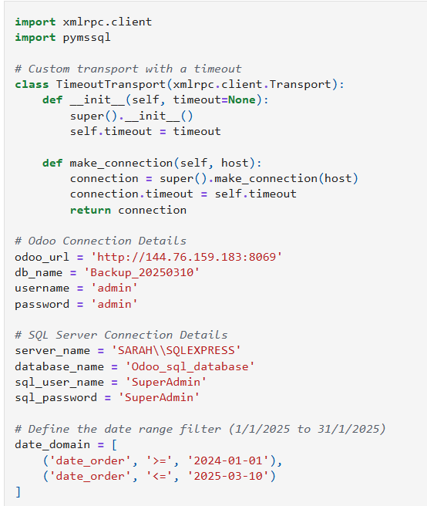
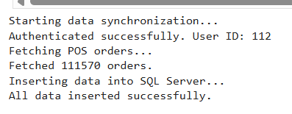
ETL (Extract, Transform, Load) Data by Python:

Slide 9
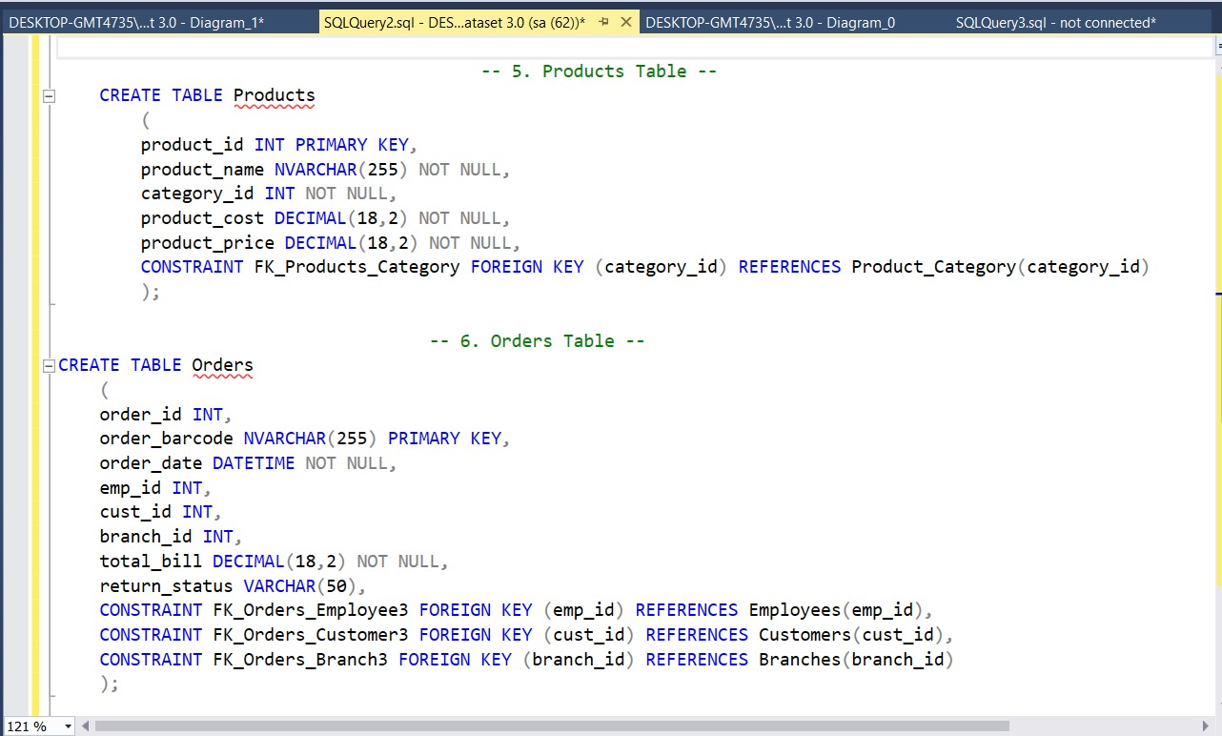
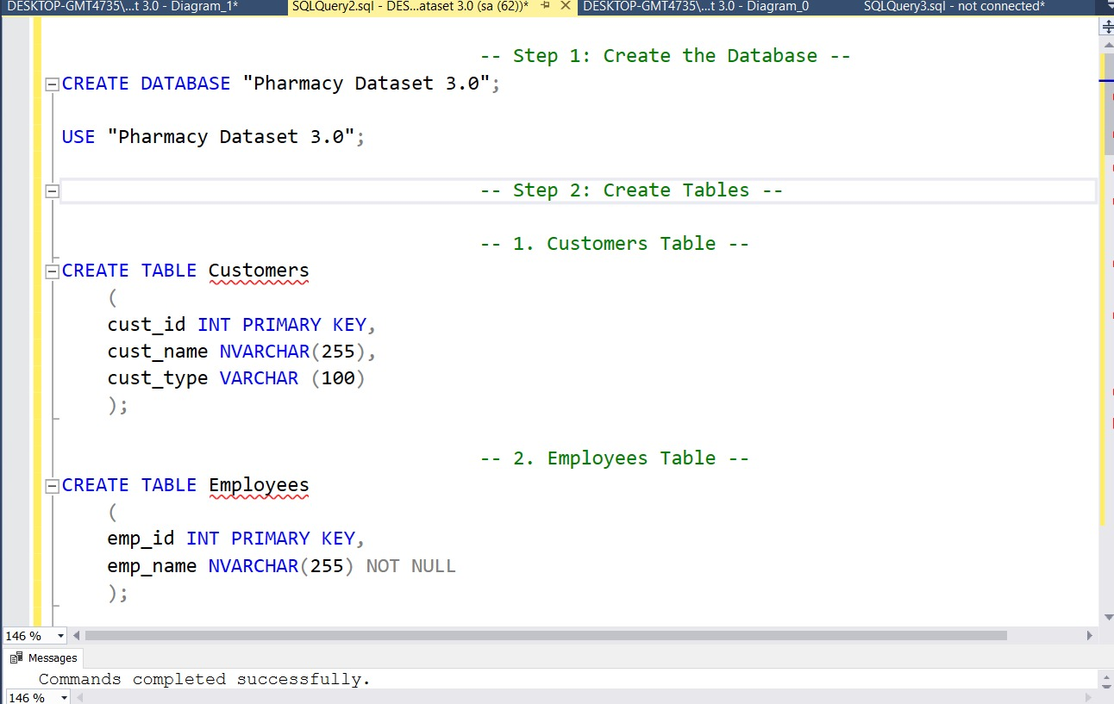
SQL Queries

Slide 10
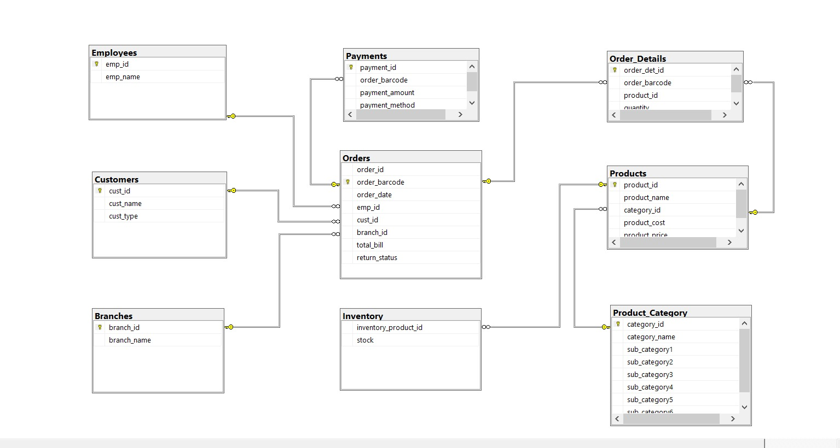
SQL Data Modeling :

Slide 11
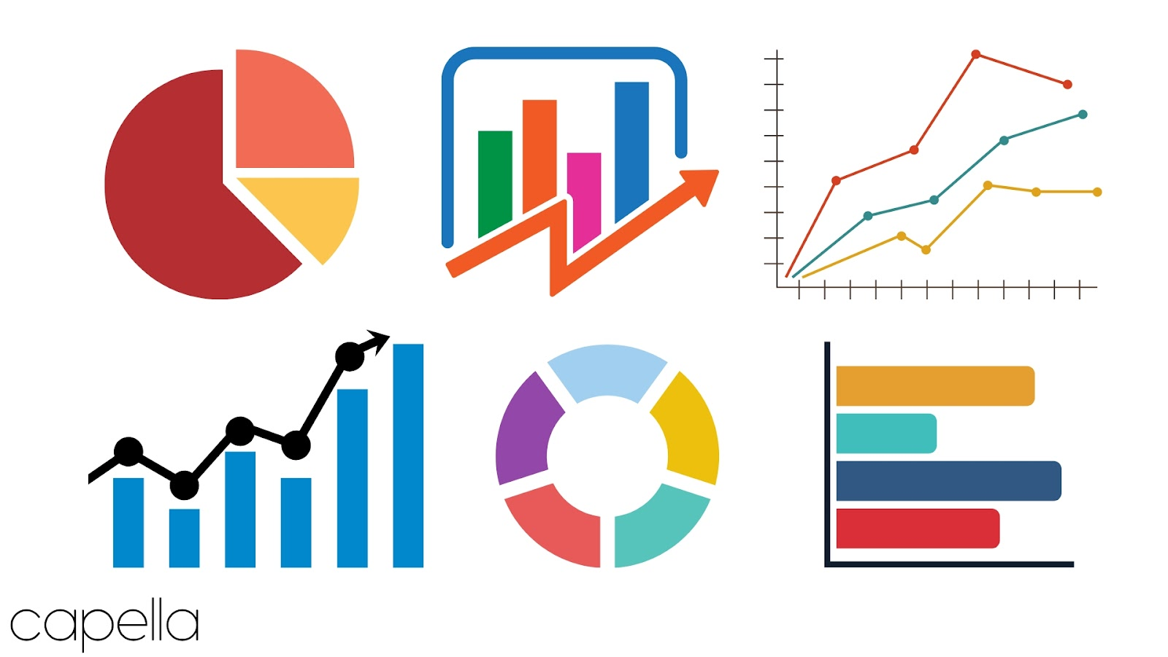
Data Analysis and Dashboards

Slide 12
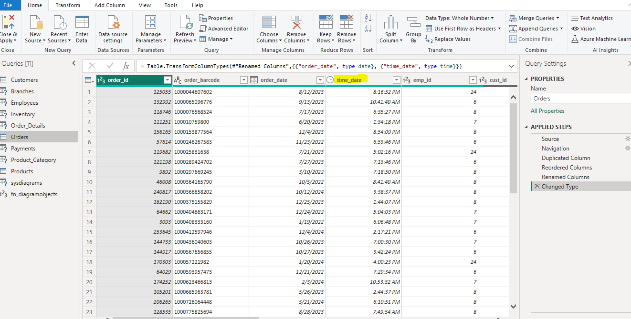
Power Query: Editing Data.

Slide 13
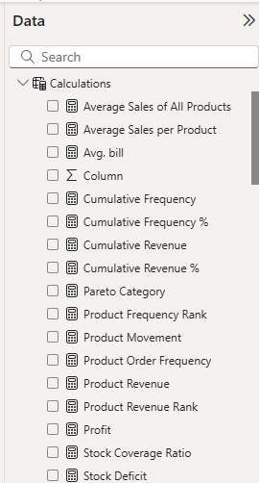
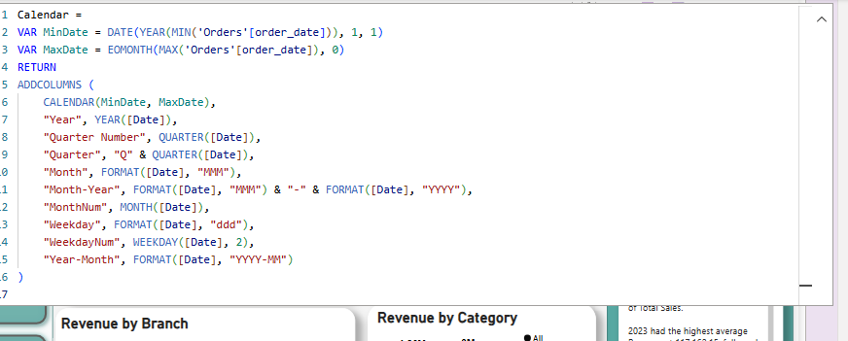
Adding further Calculations and Calender

Slide 14
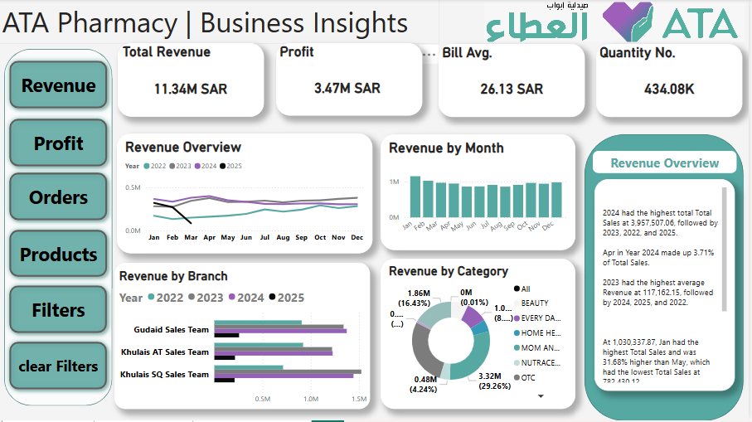
Power Bi Dashboard
Dashboard link: ATA Pharmacy - Final Project - Fabric
Revenue Dashboard
Which year recorded the highest total revenue and how did it progress monthly?
What was the revenue trend by month, and which month had the highest sales?
How did branch revenue performance compare across 2022–2025?
Which product category contributed the most to revenue overall?

Slide 15
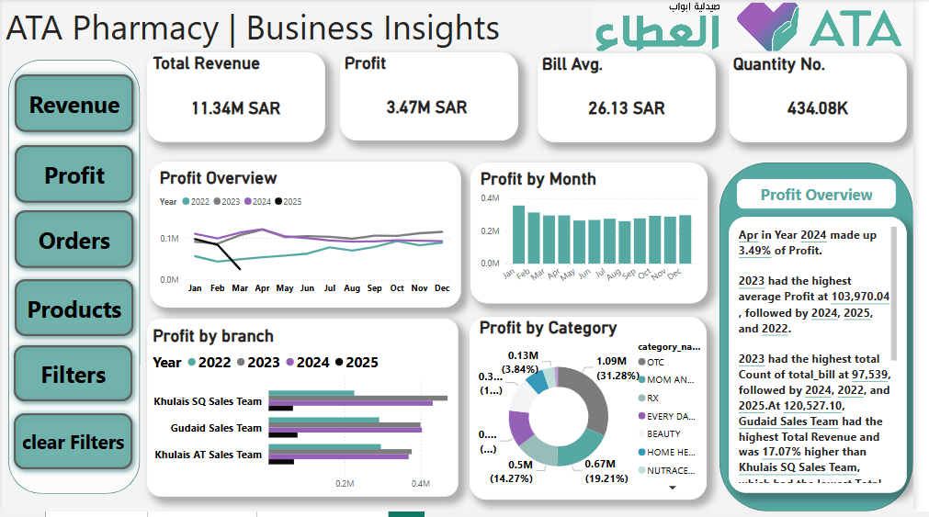
Profit Overview Dashboard
What was the total revenue and profit recorded across all branches?
Which month recorded the highest monthly profit across the years?
How did profit performance vary across years 2022–2025?
Which branch achieved the highest profit in 2025?
Which product category contributed the most to the total profit?

Slide 16
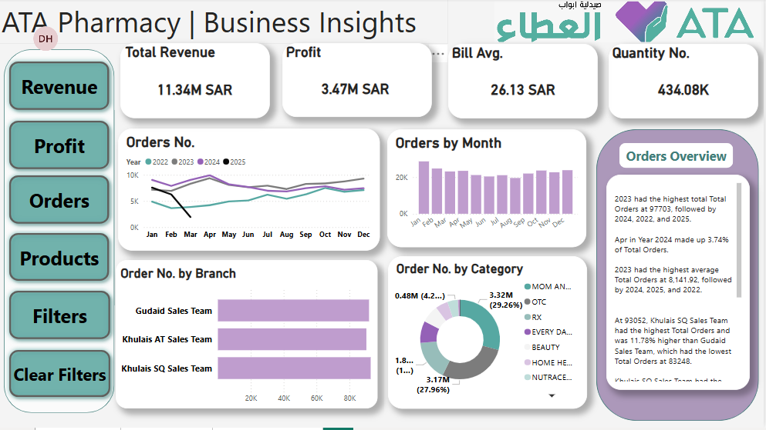
Orders Dashboard
Which year experienced the sharpest rise in total orders during the first quarter?
What was the peak month for order volume across all years?
Which branch had the highest total order count?
Which product category led in total order numbers?
Which year had the highest total orders and how do the branches compare in volume?

Slide 17
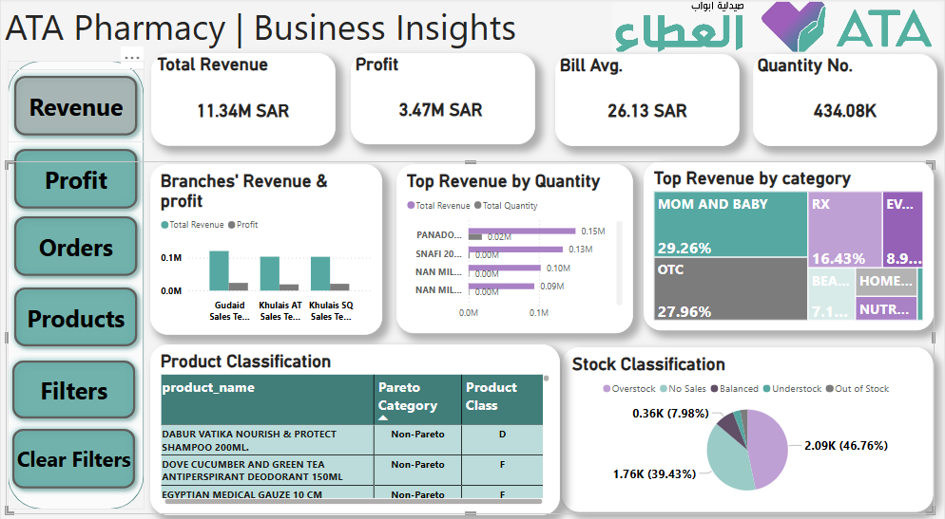
Product & Stock Details Dashboard
How does revenue compare to profit across branches?
Which products had the highest revenue and quantity sold?
Which product category generated the most revenue overall?
Which products are classified as Pareto and what is their class type?
What percentage of stock is understocked, out of stock, and balanced?

Slide 18
Thank you
Q & A ?!

